Slide 1
Binary Maximal Correlation
Information Theory Course project
Dror Drach, Co-Advised by Dr. Ofer Shayevitz and Dr. Or Ordentlich

Slide 2
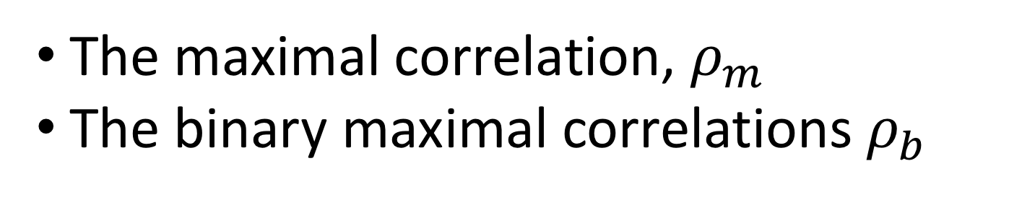
We’ll talk about 2 measures of dependence:
The maximal correlation, $ρ_{m}$
The binary maximal correlations $ρ_{b}$

Slide 3

Background

Slide 4
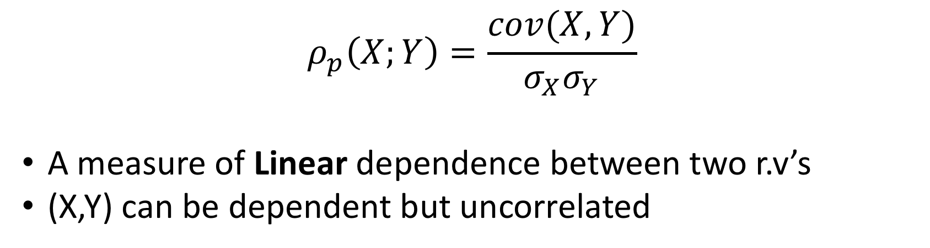
Pearson Correlation Coefficient
$$ρ_{p}\left(X;Y\right)=\frac{cov(X,Y)}{σ_{X}σ_{Y}}$$
A measure of Linear dependence between two r.v’s
(X,Y) can be dependent but uncorrelated

Slide 5
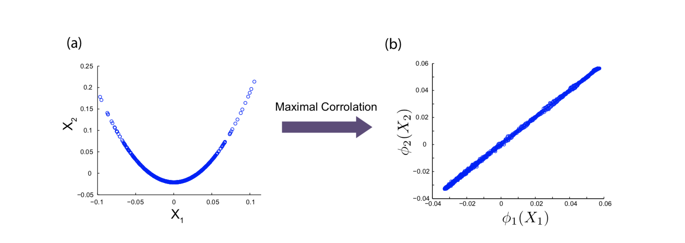
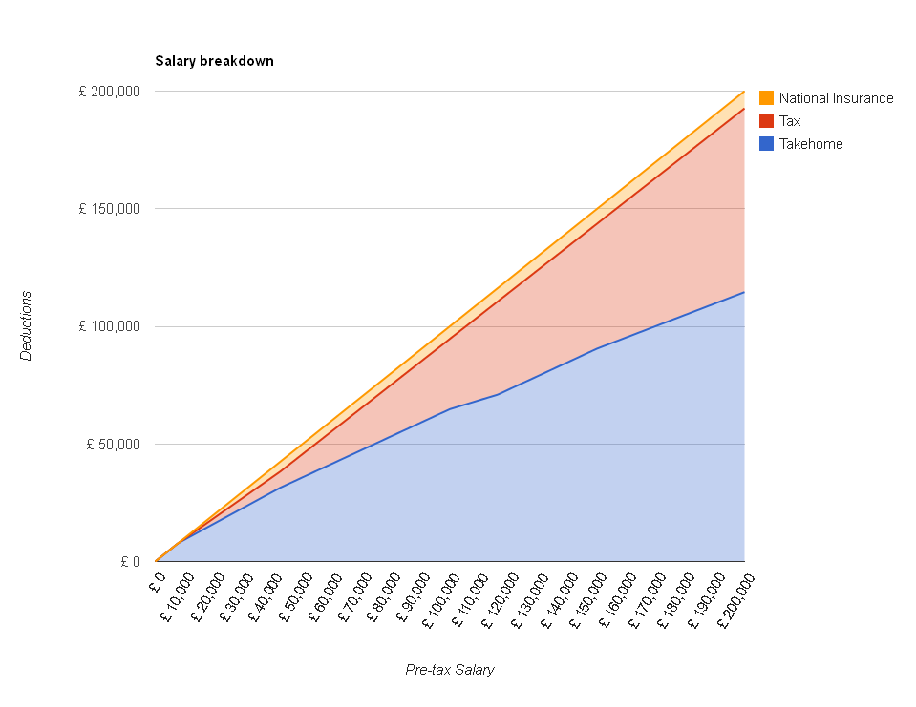
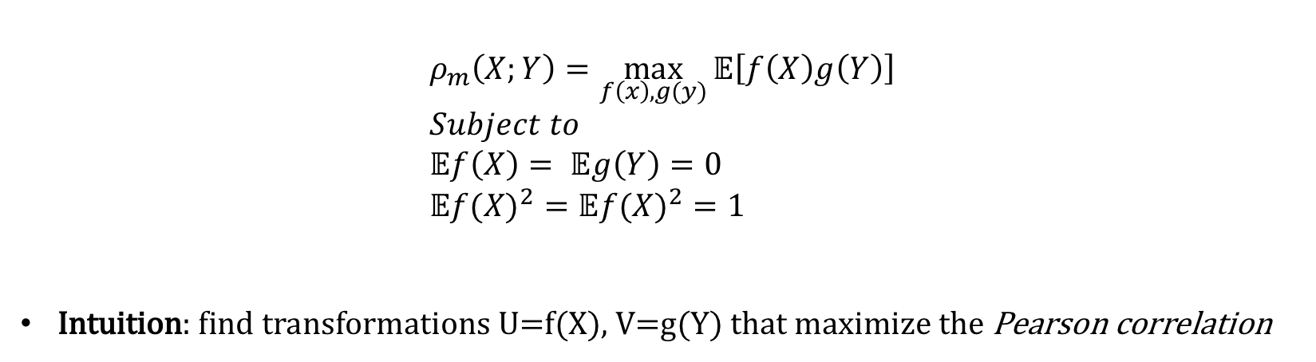
Hirschfeld-Gebelein-Renyi Maximal Correlation
$$ρ_{m}\left(X;Y\right)=\max_{f\left(x\right),g(y)}{𝔼\left[f\left(X\right)g\left(Y\right)\right]} \\ Subject to \\ 𝔼f\left(X\right)= 𝔼g\left(Y\right)=0 \\ 𝔼{f(X)}^{2}=𝔼{f(X)}^{2}=1$$
Intuition: find transformations U=f(X), V=g(Y) that maximize the Pearson correlation
Simple example: Wages
(Before and after tax)
[*]
[*] Feizi et al. Network Maximal Correlation

Slide 6
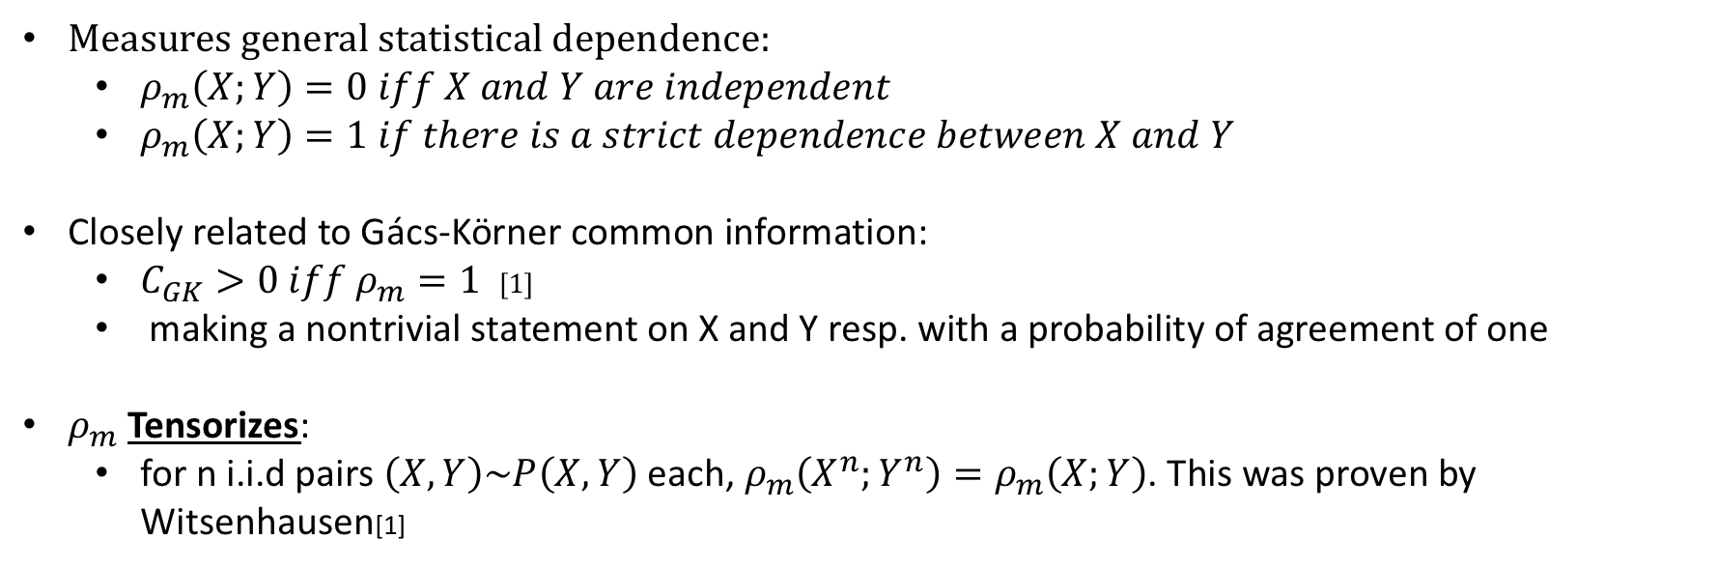

Some properties of $ρ_{m}$:
Measures general statistical dependence:
$ρ_{m}\left(X;Y\right)=0 iff X and Y are independent$
$ρ_{m}\left(X;Y\right)=1 if there is a strict dependence between X and Y$
Closely related to Gács-Körner common information:
$C_{GK}>0 iff ρ_{m}=1$ [1]
making a nontrivial statement on X and Y resp. with a probability of agreement of one
$ρ_{m}$Tensorizes:
for n i.i.d pairs $\left(X,Y\right)\sim P\left(X,Y\right)$ each, $ρ_{m}\left(X^{n};Y^{n}\right)=ρ_{m}\left(X;Y\right)$. This was proven by Witsenhausen[1]
[1] H.S. Witsenhausen, On sequences of pairs of dependent random variables

Slide 7
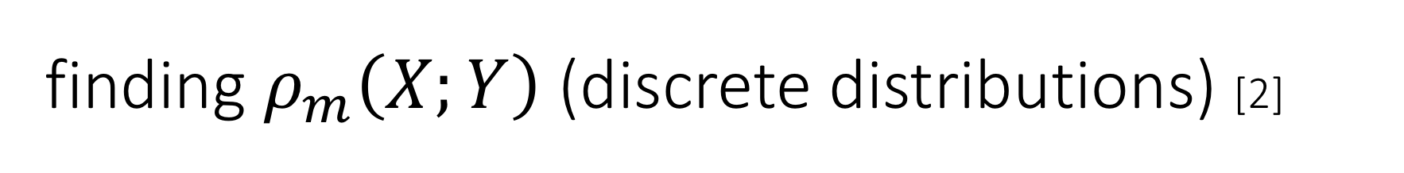
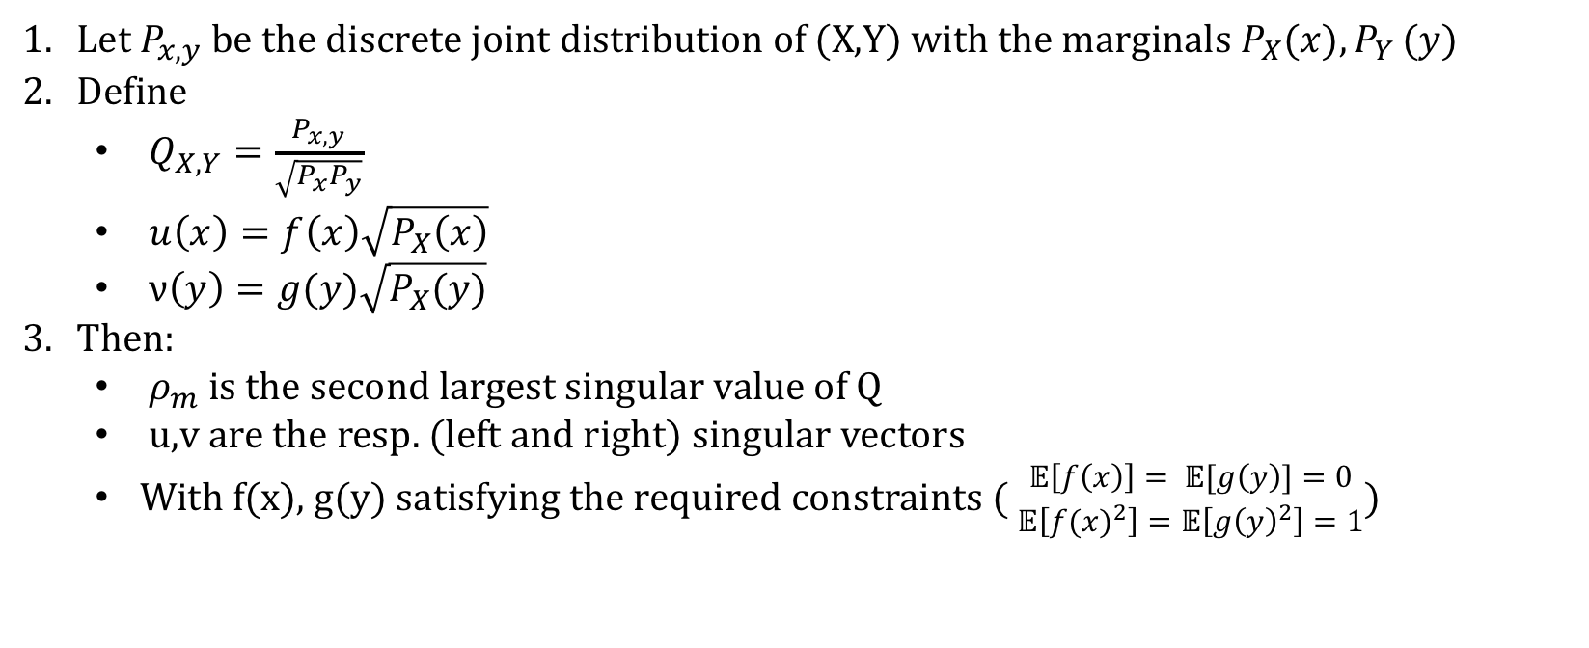
finding $ρ_{m}\left(X;Y\right)$ (discrete distributions) [2]
Let $P_{x,y}$ be the discrete joint distribution of (X,Y) with the marginals $P_{X}(x){,P}_{Y}(y)$
Define
$Q_{X,Y}=\frac{P_{x,y}}{\sqrt{P_{x}P_{y}}}$
$u\left(x\right)=f\left(x\right)\sqrt{P_{X}\left(x\right)}$
$ν\left(y\right)=g(y)\sqrt{P_{X}(y)}$
T$hen:$
$ρ_{m}$ is the second largest singular value of Q
u,v are the resp. (left and right) singular vectors
With f(x), g(y) satisfying the required constraints ( $\begin{aligned}𝔼\left[f\left(x\right)\right]= 𝔼[g\left(y\right)]=0 \\ 𝔼\left[{f(x)}^{2}\right]=𝔼\left[{g\left(y\right)}^{2}\right]=1\end{aligned}$)
[2] G. Kumar. On Sequences of Pairs of Dependent Random Variables A simpler proof of the main result using SVD

Slide 8
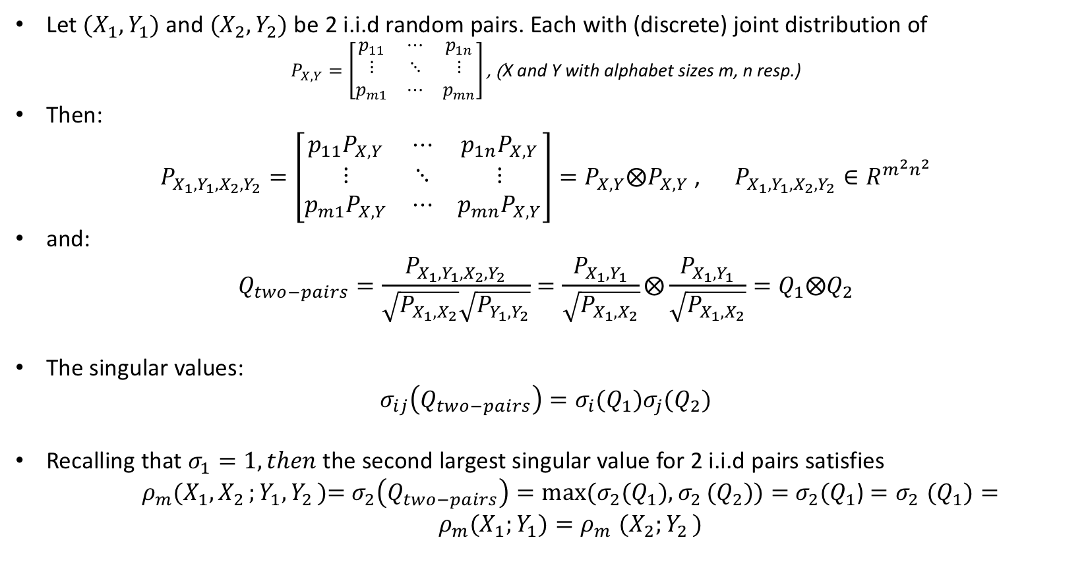
Tensorization, revisited:
Let ${(X}_{1},Y_{1})$ and ${(X}_{2},Y_{2})$ be 2 i.i.d random pairs. Each with (discrete) joint distribution of
$P_{X,Y}=\left[\begin{matrix}p_{11} & ⋯ & p_{1n} \\ ⋮ & ⋱ & ⋮ \\ p_{m1} & ⋯ & p_{mn}\end{matrix}\right]\text{, (}\text{X} \text{and} \text{Y} \text{with} \text{alphabet} \text{sizes} \text{m}\text{, }\text{n} \text{resp}\text{.}$)
Then:
$P_{X_{1},Y_{1}{,X}_{2}{,Y}_{2}}=\left[\begin{matrix}p_{11}P_{X,Y} & ⋯ & p_{1n}P_{X,Y} \\ ⋮ & ⋱ & ⋮ \\ p_{m1}P_{X,Y} & ⋯ & p_{mn}P_{X,Y}\end{matrix}\right]={P_{X,Y}⨂P}_{X,Y}$ , $P_{X_{1},Y_{1}{,X}_{2}{,Y}_{2}}∈R^{m^{2}n^{2}}$
and:
$$Q_{two−pairs}=\frac{P_{X_{1},Y_{1}{,X}_{2}{,Y}_{2}}}{\sqrt{P_{X_{1}{,X}_{2}}}\sqrt{P_{Y_{1}{,Y}_{2}}}}=\frac{P_{X_{1},Y_{1}}}{\sqrt{P_{X_{1}{,X}_{2}}}}⨂\frac{P_{X_{1},Y_{1}}}{\sqrt{P_{X_{1}{,X}_{2}}}}=Q_{1}⨂Q_{2}$$
The singular values:
$$σ_{ij}\left(Q_{two−pairs}\right)={σ_{i}(Q}_{1}){σ_{j}(Q}_{2})$$
Recalling that $σ_{1}=1, then$the second largest singular value for 2 i.i.d pairs satisfies
${ρ_{m}(X_{1}{,X}_{2};Y_{1}{,Y}_{2})\text{=} σ}_{2}\left(Q_{two−pairs}\right)={{max⁡(σ}_{2}(Q}_{1}){{,σ}_{2}(Q}_{2}))=$ ${σ_{2}(Q}_{1}$) ${{=σ}_{2}(Q}_{1})=ρ_{m}(X_{1};Y_{1}){=ρ}_{m}(X_{2}{;Y}_{2})$

Slide 9
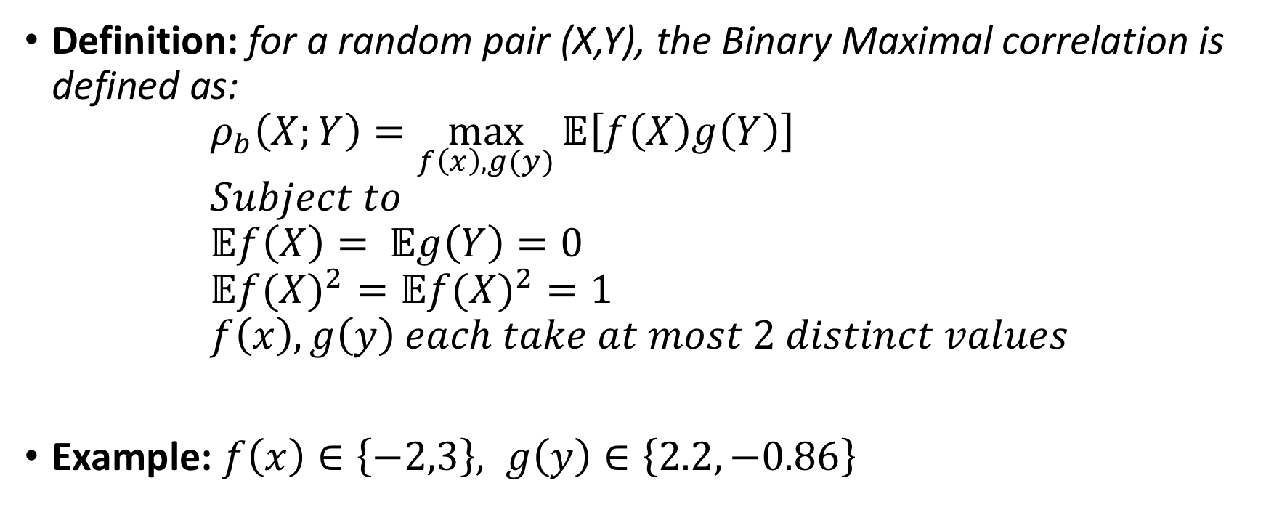
Binary Maximal Correlation
Definition: for a random pair (X,Y), the Binary Maximal correlation is defined as:
$$ρ_{b}\left(X;Y\right)=\max_{f\left(x\right),g(y)}{𝔼\left[f\left(X\right)g\left(Y\right)\right]} \\ Subject to \\ 𝔼f\left(X\right)= 𝔼g\left(Y\right)=0 \\ 𝔼{f(X)}^{2}=𝔼{f(X)}^{2}=1 \\ f\left(x\right),g\left(y\right) each take at most 2 distinct values$$
Example: $f\left(x\right)∈\left\{−2,3\right\}, g\left(y\right)∈\left\{2.2,−0.86\right\}$

Slide 10
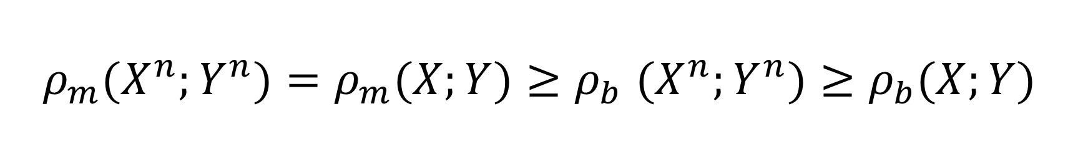
Recap:
$$ρ_{m}{(X}^{n};Y^{n})=ρ_{m}(X;Y){≥ρ}_{b}(X^{n};Y^{n})≥ρ_{b}(X;Y)$$

Slide 11

Problem Statement

Slide 12
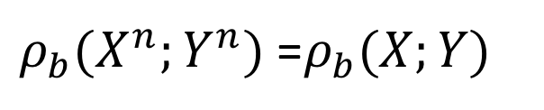

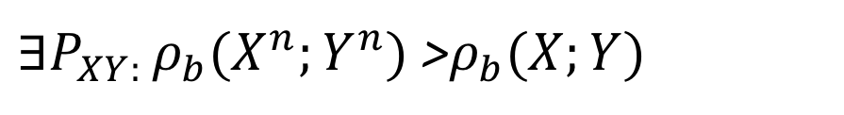
Does $ρ_{b}$ tensorize?
YES
NO
$ρ_{b}(X^{n};Y^{n})$ =$ρ_{b}(X;Y)$
${∃P_{XY: }ρ}_{b}(X^{n};Y^{n})$ >$ρ_{b}(X;Y)$
Proof?
Counter example?
Behaviour with n?

Slide 13

Our contribution

Slide 14





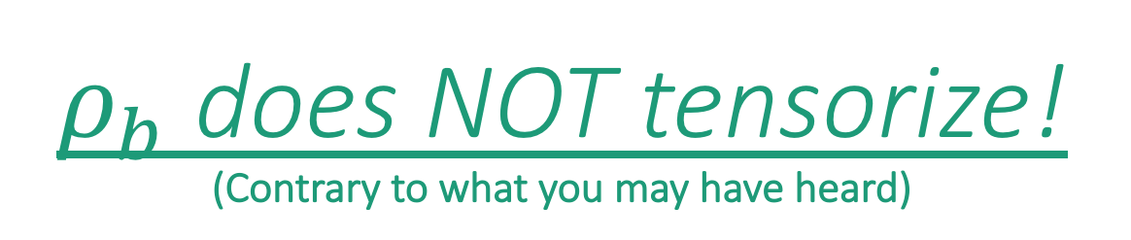
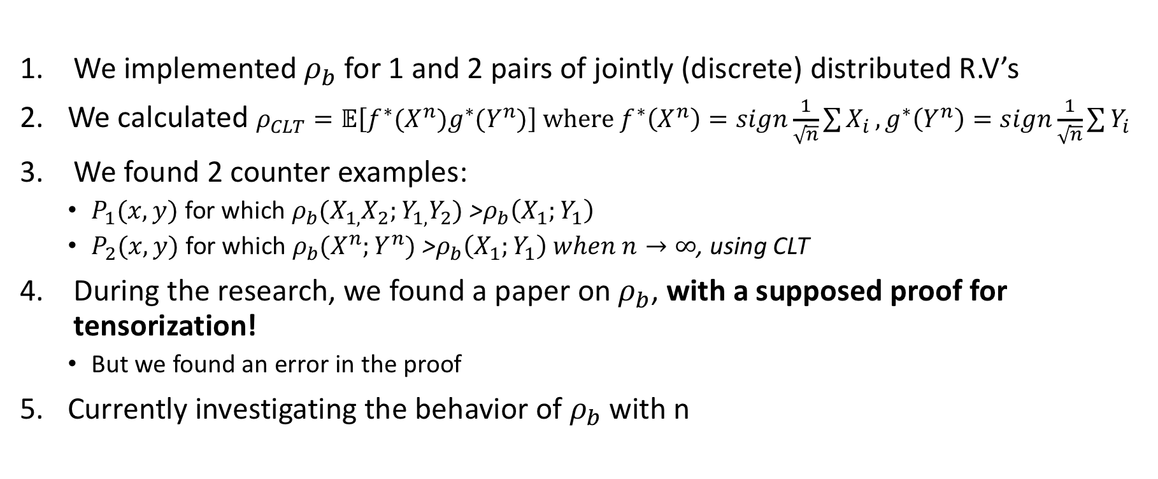
$ρ_{b}$ does NOT tensorize! (Contrary to what you may have heard)
We implemented $ρ_{b}$ for 1 and 2 pairs of jointly (discrete) distributed R.V’s
We calculated $ρ_{CLT}=𝔼\left[f^{∗}(X^{n})g^{∗}(Y^{n})\right] where f^{∗}\left(X^{n}\right)=sign\frac{1}{\sqrt{n}}\sum{X_{i}},g^{∗}\left(Y^{n}\right)=sign\frac{1}{\sqrt{n}}\sum{Y_{i}}$
We found 2 counter examples:
$P_{1}(x,y)$ for which $ρ_{b}(X_{1,}X_{2};Y_{1,}Y_{2})$ >$ρ_{b}\left(X_{1};Y_{1}\right)$
$P_{2}(x,y)$ for which $ρ_{b}(X^{n};Y^{n})$ >$ρ_{b}\left(X_{1};Y_{1}\right) when n→∞$, using CLT
During the research, we found a paper on $ρ_{b}$, with a supposed proof for tensorization!
But we found an error in the proof
Currently investigating the behavior of $ρ_{b}$with n

Slide 15
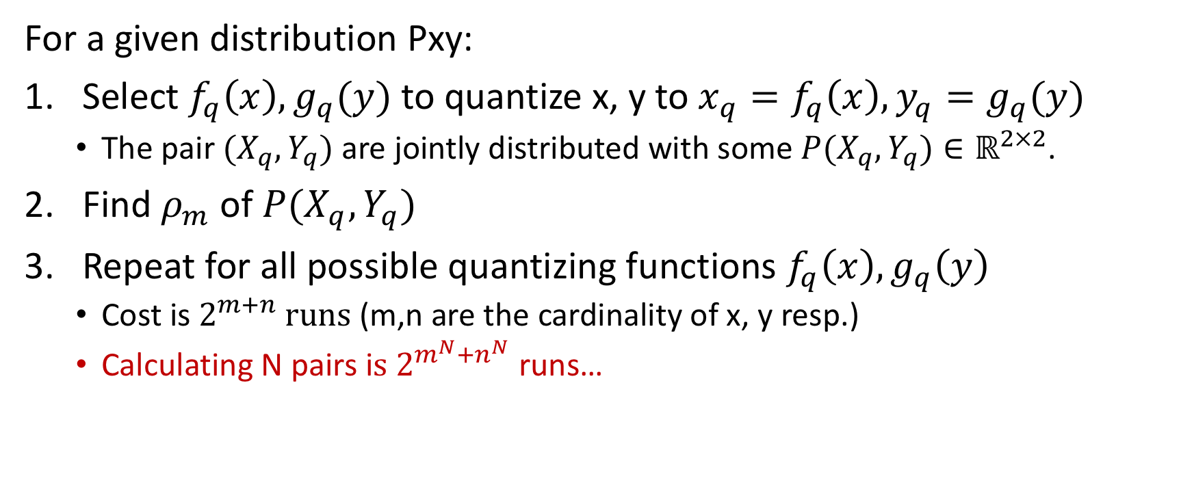

Some Implementation Details: finding $ρ_{b}$
For a given distribution Pxy:
Select $f_{q}\left(x\right),g_{q}(y)$ to quantize x, y to ${x_{q}=f}_{q}\left(x\right),{y_{q}=g}_{q}(y)$
The pair ${(X}_{q},Y_{q})$ are jointly distributed with some $P(X_{q},Y_{q})∈ℝ^{2×2}$.
Find $ρ_{m}$of $P(X_{q},Y_{q})$
Repeat for all possible quantizing functions $f_{q}\left(x\right),g_{q}\left(y\right)$
Cost is $2^{m+n} runs$ (m,n are the cardinality of x, y resp.)
Calculating N pairs i$s 2^{m^{N}{+n}^{N}}$runs…

Slide 16
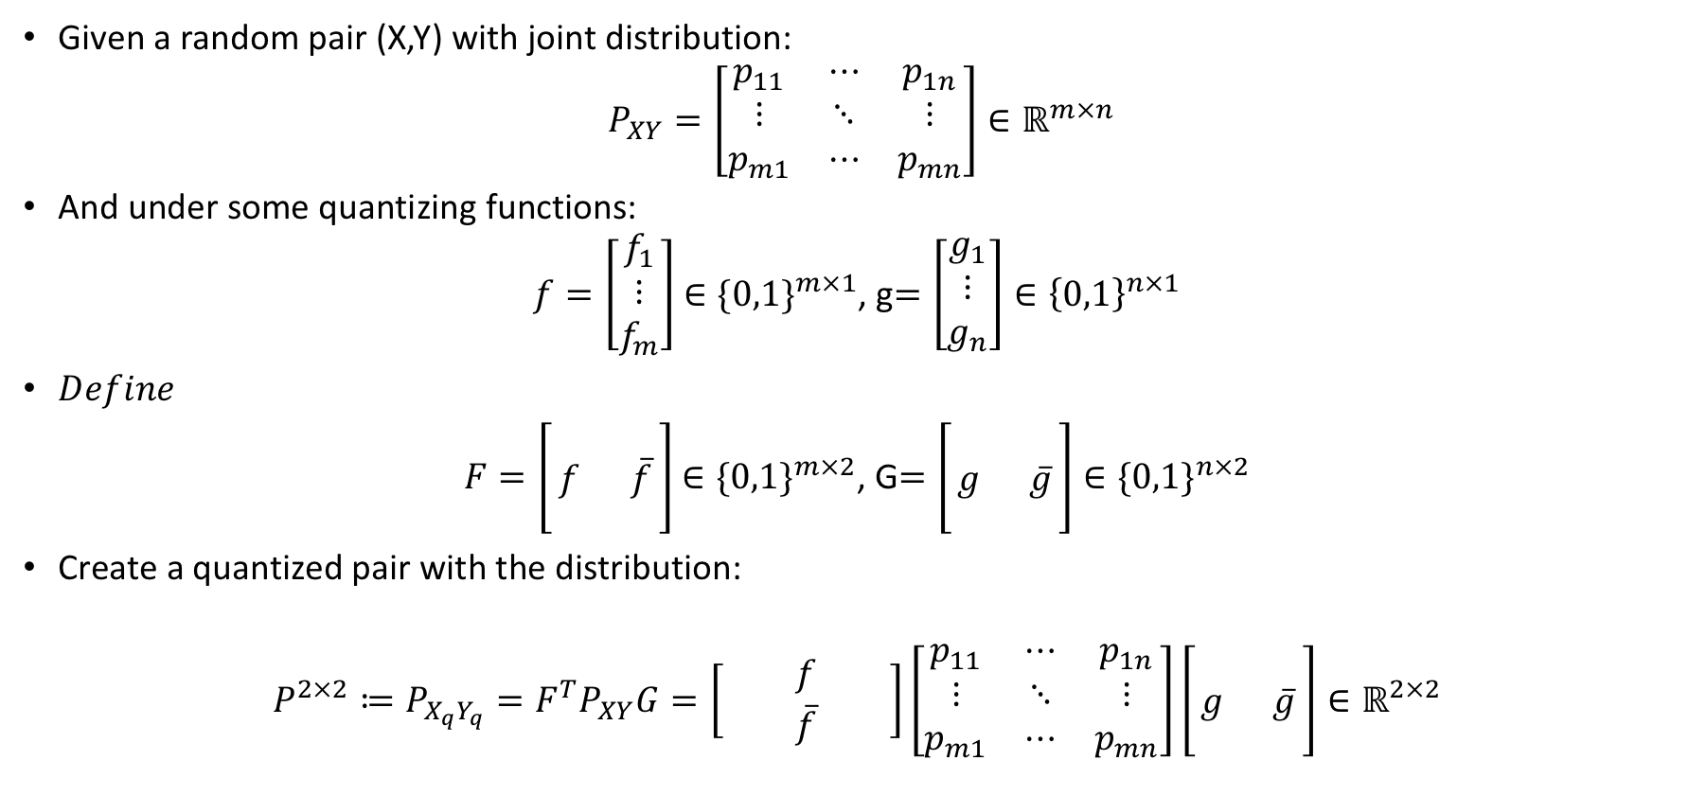
Implementing the Binary correlation:
Given a random pair (X,Y) with joint distribution:
$P_{XY}=\left[\begin{matrix}p_{11} & ⋯ & p_{1n} \\ ⋮ & ⋱ & ⋮ \\ p_{m1} & ⋯ & p_{mn}\end{matrix}\right]∈ℝ^{m×n}$
And under some quantizing functions:
$f=\left[\begin{matrix}f_{1} \\ ⋮ \\ f_{m}\end{matrix}\right]$ $∈{\{0,1\}}^{m×1}$, g$=\left[\begin{matrix}g_{1} \\ ⋮ \\ g_{n}\end{matrix}\right]∈{\left\{0,1\right\}}^{n×1}$
$Define$
$F=\left[\begin{matrix} & \\ f & \overline{f} \\ & \end{matrix}\right]$ ${∈\{0,1\}}^{m×2}$, G$=\left[\begin{matrix} & \\ g & \overline{g} \\ & \end{matrix}\right]{∈\{0,1\}}^{n×2}$
Create a quantized pair with the distribution:
$$P^{2×2}≔P_{X_{q}Y_{q}}=F^{T}P_{XY}G=\left[\begin{matrix} & f & \\ & \overline{f} & \end{matrix}\right]\left[\begin{matrix}p_{11} & ⋯ & p_{1n} \\ ⋮ & ⋱ & ⋮ \\ p_{m1} & ⋯ & p_{mn}\end{matrix}\right]\left[\begin{matrix} & \\ g & \overline{g} \\ & \end{matrix}\right]∈ℝ^{2×2}$$

Slide 17

Results

Slide 18
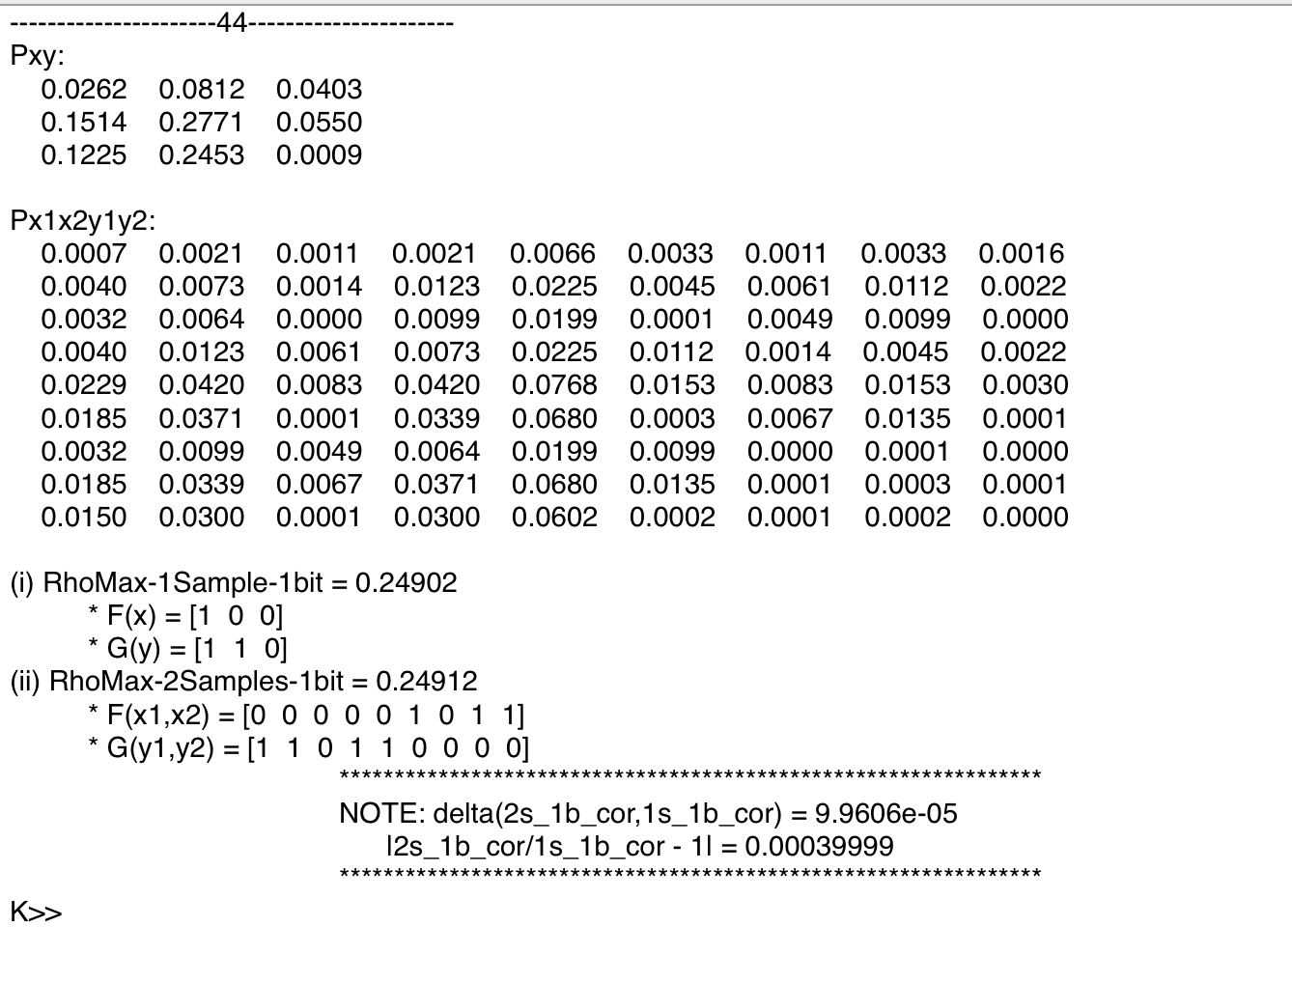
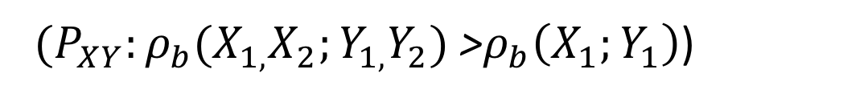
Counter example 1:
Two-pairs
${{ (P}_{XY}:ρ}_{b}(X_{1,}X_{2};Y_{1,}Y_{2})$ >$ρ_{b}\left(X_{1};Y_{1}\right)$)

Slide 19
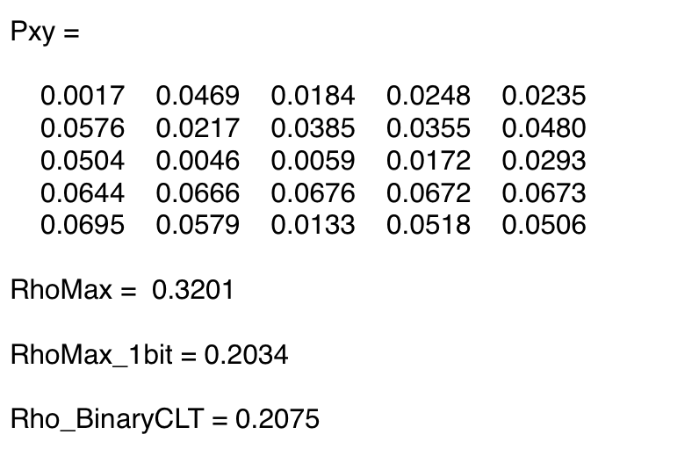
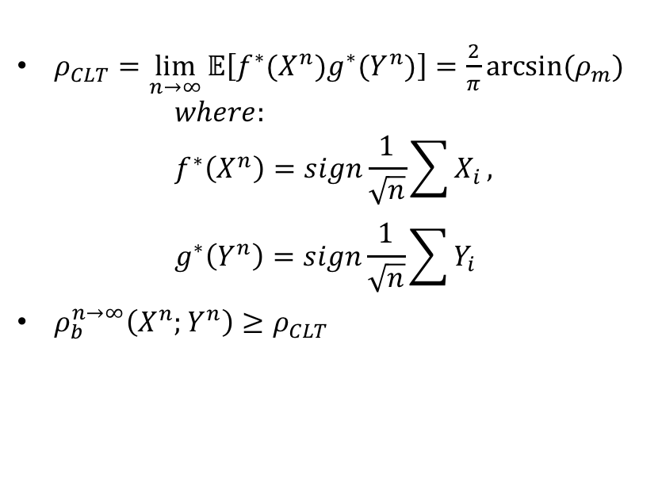
Counter example 2:
Educated guess (CLT)
${{(P}_{XY}:ρ}_{b}(X^{n};Y^{n})$ >$ρ_{b}\left(X_{1};Y_{1}\right) when n→∞$)
$ρ_{CLT}=\lim_{n→∞}{𝔼\left[f^{∗}(X^{n})g^{∗}(Y^{n})\right]}=\frac{2}{π}arcsin⁡(ρ_{m})$
$$where: \\ f^{∗}\left(X^{n}\right)=sign\frac{1}{\sqrt{n}}\sum{X_{i}}, \\ g^{∗}\left(Y^{n}\right)=sign\frac{1}{\sqrt{n}}\sum{Y_{i}}$$
$ρ_{b}^{n→∞}\left(X^{n};Y^{n}\right)≥ρ_{CLT}$

Slide 20

The issue with Kumar’s proof
[4] G. Kumar, Binary Renyi Correlation A simpler proof of Witsenhausen’s result and a tighter upper bound

Slide 21
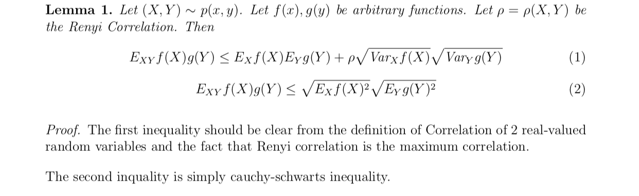
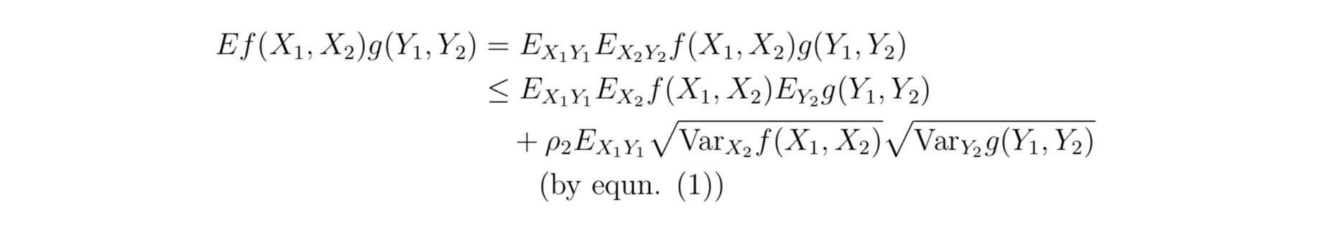
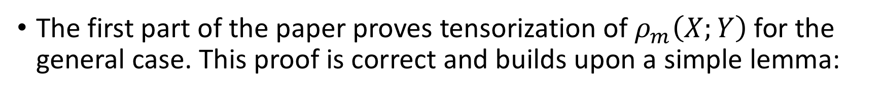
The first part of the paper proves tensorization of $ρ_{m}\left(X;Y\right)$for the general case. This proof is correct and builds upon a simple lemma:
In the proof, the lemma is used under conditional expectation:
(The correct synthax should be $(…)=𝔼_{X_{1}Y_{1}}𝔼_{X_{2}Y_{2}|X_{1}Y_{1}}(…))$
[4] G. Kumar, Binary Renyi Correlation A simpler proof of Witsenhausen’s result and a tighter upper bound

Slide 22
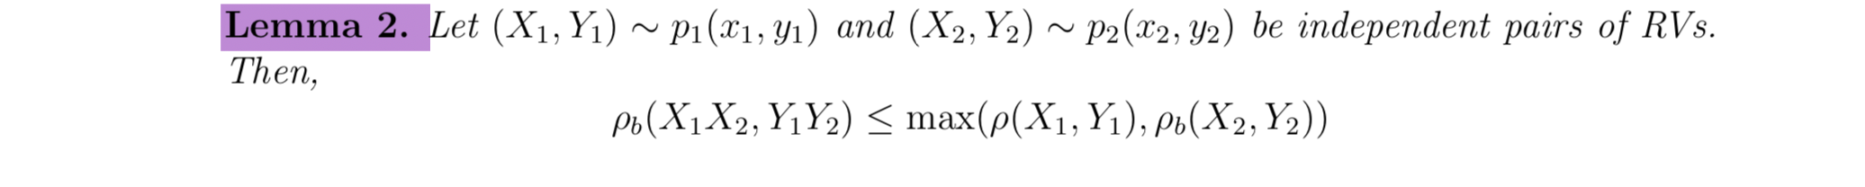
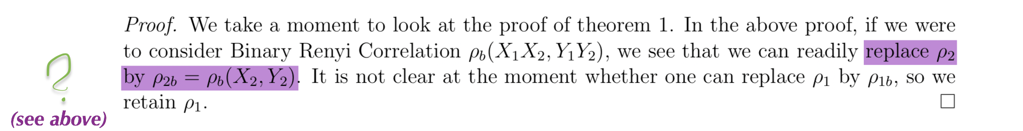

The Second part deals with the binary form $ρ_{b}\left(X;Y\right)$, and states the following lemma:
[4] G. Kumar, Binary Renyi Correlation A simpler proof of Witsenhausen’s result and a tighter upper bound

Slide 23
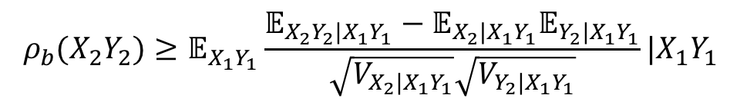
Going back to the required transition:
The new claim essentially is:
$$ρ_{b}(X_{2}Y_{2})≥𝔼_{X_{1}Y_{1}}\frac{𝔼_{X_{2}Y_{2}|X_{1}Y_{1}}−𝔼_{X_{2}|X_{1}Y_{1}}𝔼_{Y_{2}|X_{1}Y_{1}}}{\sqrt{V_{X_{2}|X_{1}Y_{1}}}\sqrt{V_{Y_{2}|X_{1}Y_{1}}}}|X_{1}Y_{1}$$
But this doesn’t hold under the conditional expectation and the binary constraint
[4] G. Kumar, Binary Renyi Correlation A simpler proof of Witsenhausen’s result and a tighter upper bound

Slide 24

Summary

Slide 25
1. The maximal correlation tensorizes 2. The binary version doesn’t 3. Be careful with conditional expectations

Slide 26

Thank you!

Slide 27
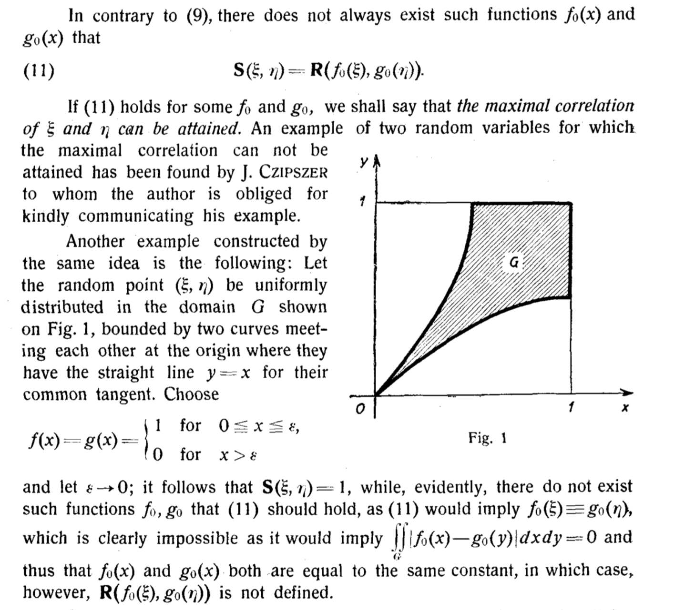
Max or sup?
The question is of attainability

